Slide 1
HYBRID SEED PRODUCTION OF HORTICULTURAL CROPS

Slide 2
Introduction
Since 100 years ago, hybrid crops are produced from hybrid seeds and become dominated commercial crop.
developed by the hybridization or crossing of parent lines that are ‘pure lines’ produced through inbreeding.
Pure lines: plants that “breed true” or produce sexual offspring that closely resemble their parents.
  By crossing pure lines, a uniform population of F1 hybrid seed can be produced with predictable characteristics.
Heterosis: A universal phenomenon that F1 generation shows superiority to both parents
  Due to heterosis growing of hybrid seed have advantage as compared to inbred lines.

Slide 3
Introduction
The cross between inbred varieties and well-documented and consistent phenotypes (such as yield) and the resulting hybrid seed is collected.
Another important factor => the combining ability of the parent plants.
Hybrids are bred to have good characteristics in the resulting plants, such as better yield, improved color, disease resistance etc.
the crosses are specific and controlled.

Slide 4
Characteristics of Hybrid Seeds
Trueness to name:
  seeds in question have been labeled with the correct species name, cultivar name, or whatever is appropriate.
Trueness to type:
  this means that the seeds in question also produce progeny that conform to visual and genetic standards for that cultivar or species.
Freedom from contaminants:
  this includes pathogens, mixtures of other crop seeds, and weed seeds.

Slide 5
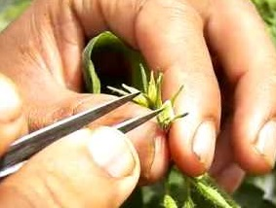
Method of Hybrid Seed Production
Preparation for hybridization:
  Selection of two distinct parents
  Development of inbred lines by self pollinating both parents by 6-7 generations
Planting:
  At the time of planting isolation distance between the crops is maintained. Strict roughing of other plants is done.
    In onions and carrots, isolation distances from 400 to 1500 meters may be required.
  At the time of flowering, flowers of female parents are emasculated before anther dehiscence.

Slide 6
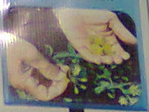


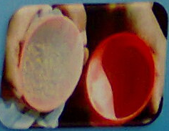
Method of Hybrid Seed Production
Pollen collection:
  Flower collection
  Anther cones are taken and put them in glassine envelopes
  Dry anthers at 30 c for 24 hours
  Put the dried anther cones in a cup then transfer the pollen lid cup

Slide 7
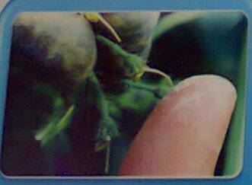
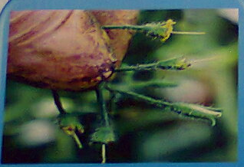
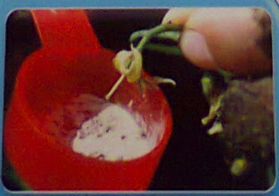
Method of Hybrid Seed Production
Pollination:
  Exposing the stigma in two ways
    (1) pollinate using fingers
    (2) dipping the stigma in pollen

Slide 8
Method of Hybrid Seed Production
Fruit setting:
  In fruit setting 30-40 fruits are maintained per plant
Harvesting:
  Harvest when fruit fully mature and put the fruit in nonmetallic containers
Seed extraction:
  There are two methods of extraction
    (1) dry extraction
    (2) wet extraction
  It depends upon type of fruit
Seed processing:

Slide 9
Other Methods of Hybrid Seed Production
Single cross hybrids (F1 hybrids):
  Production and selection of two distinct inbred lines by selfing
  Crossing between two inbred lines
  Collecting the hybrid seed
Double cross hybrids:
  Selection of two different F1 hybrids
  Crossing the hybrids
Three way cross hybrids:
  Selection of inbred line
  Crossing the inbred line with F1 hybrid
Top-cross hybrids:
  crossing the an inbred line and an open pollinated cultivar

Slide 10
Techniques For Hybrid Seed Production
Mutation breeding:
  Plants were exposed to gamma rays, protons, neutrons, alpha particles, and beta particles to see if these would induce useful mutations. Chemicals, too, such as sodium azide and ethyl methane sulphonate, were used to cause mutations.
Examples:
  wheat, barley, rice, potatoes, soybeans, and onions.

Slide 11
Objectives of Hybrid Seed Production
Yield improvements
Disease and insect resistance
Seed Composition
Forage quality
Tolerance to environmental stresses
Adaptability to mechanization
Lodging resistance
Photoperiod response
Drought stresses

Slide 12
Advantages of Using Hybrid Seeds
Hybrids can have up to 25 percent higher yield.
Hybrid plants are physically uniform. This is advantageous for farmers who harvest with machines, but it’s usually not a big deal for small-greenhouse gardeners.
Hybrids often show greater vigor and faster growth.

Slide 13
Disadvantages of Using Hybrid Seeds
Hybrids cost up to five times more
  Because they take longer time to develop and are more trouble to produce.
They often require a more exacting horticulture. When things aren’t optimum, they may suffer more than plants grown from non hybrid, open-pollinated seeds.
Seeds from an F1 hybrid plant, don’t have a similar plant in the next generation.
  Resulting plants in the second generation are usually much lower yielding, have less vigor, and are quite variable in their physical characteristics.

Slide 14
Future of Hand Pollinated F1 Vegetable Hybrid Seed Production
The present state of the hand-pollinated F1 vegetable hybrid seed production industry is entering a stabilizing phase
This stabilizing phase will become even more settled in the coming years
the current main production countries still process the flexibility and cushion in term of available new locations and human resources to provide for new expansion and cost-effective pollinators
the vegetable hybrid seed industry will thus continue to explore and move to new, better and more cost-effective areas and countries.

Slide 15
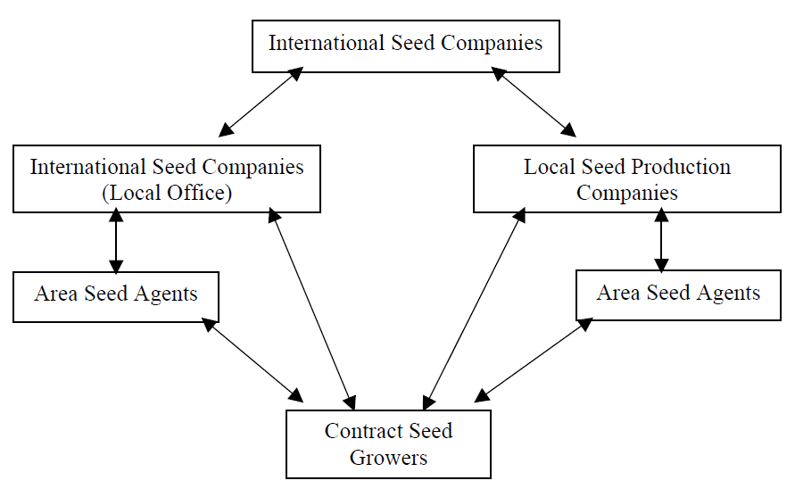
Summary of Contract System of F1 Vegetable Hybrid Seed Production

Slide 16
RNAi for Male Sterility
RNAi => male sterility & valuable in the hybrid seed industry
Genes __expressed in tissues ___involved in pollen production ____targeted through RNAi.
Scientists developed male sterile tobacco lines by inhibiting the expression of
  TA29, a gene necessary for pollen development.
  Msh1 (tobacco and tomato) , rearrangements in the mitochondrial DNA associated with naturally occurring cytoplasmic male sterility

Slide 17
Hybrid vigor,
Hybrid vigor, also known as heterosis, refers to the phenomenon where the offspring of a cross between two different parent plants exhibit superior traits compared to their parents. It is a common observation in plant breeding and is a result of the combination and interaction of different genetic traits from the parental lines.

Slide 18
Here are some key points about hybrid vigor:
Genetic Diversity: Hybrid vigor occurs due to the increased genetic diversity resulting from the combination of two different parental lines. When two genetically diverse parents are crossed, the offspring can inherit a wide range of alleles, which can lead to enhanced traits and performance.
Superior Traits: The hybrid offspring often display improved traits such as increased growth rate, higher yield, better disease resistance, improved stress tolerance, and overall better performance compared to the parents. This enhanced performance is particularly significant in traits that exhibit heterozygous dominance, where the heterozygous genotype exhibits superior phenotypic expression compared to the homozygous genotypes.
Complementary Gene Action: In hybrid offspring, there can be complementary gene action, where the combination of different alleles from the parents results in improved trait expression. This can lead to enhanced physiological processes, such as increased photosynthesis, nutrient uptake efficiency, or disease resistance mechanisms.
Overdominance and Heterozygote Advantage: Hybrid vigor often results from the phenomenon of overdominance, where the heterozygous state (having two different alleles) leads to superior performance compared to either homozygous state (having two identical alleles). This advantage is sometimes referred to as the heterozygote advantage.
Applications in Plant Breeding: Hybrid vigor is extensively utilized in plant breeding to develop improved crop varieties. Breeders intentionally cross two genetically diverse parental lines to harness the benefits of hybrid vigor. This approach, known as hybrid breeding, is commonly used in crops such as maize (corn), rice, wheat, and various vegetables to develop high-yielding and superior performing hybrids.
Maintenance of Hybrid Vigor: Hybrid vigor is usually observed in the first generation of hybrid offspring (F1 generation). Subsequent generations, known as F2 and beyond, may not exhibit the same level of vigor due to the segregation of genetic traits. To maintain hybrid vigor in subsequent generations, breeders need to produce new hybrid crosses (by crossing the F1 hybrids) or use other breeding methods like recurrent selection or backcrossing to introduce new genetic diversity.
It is important to note that hybrid vigor may not be observed in all crosses or for all traits, as it depends on the specific genetic makeup and interaction between the parental lines. Nonetheless, the utilization of hybrid vigor has played a significant role in improving crop productivity and performance in agriculture.

Slide 19
References
http://www.seedconsortium.org/PUC/pdf%20files/23-Vegetable%20Hybrid%20Seed%20Production.pdf
Fundamentals of seed production 1,text.pdf
http://www.knowledgebank.irri.org/ricebreedingcourse/Powerpoints/Hybrid_Rice_Breeding_&_Seed_Production.ppt
http://en.wikipedia.org/wiki/Hybrid_seed
http://telegnome.com/hybrids.html
http://www3.syngenta.com/country/uk/sitecollectiondocuments/crops/cereals/bspb-hybrid-crop-factsheet.pdf
http://www.isaaa.org/resources/publications/pocketk/34/
Nawaz-Ul-Rehman M.S. et al. (2007) Molecular Biotechnology 36: 159-165

Slide 20


